Slide 1
Refilling Vibrator Lube Oil Reservoir
6.11.24 version 1.0

Slide 2
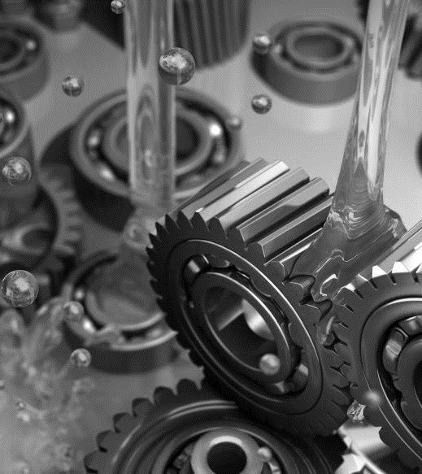
Assumptions and Prerequisite Skills
Must be capable of lifting and controlling 30 pounds
Supplies Needed
Standard PPE
Ladder
Blue Oil Container
Black Funnel
2 Blue Surface Rags

Slide 3
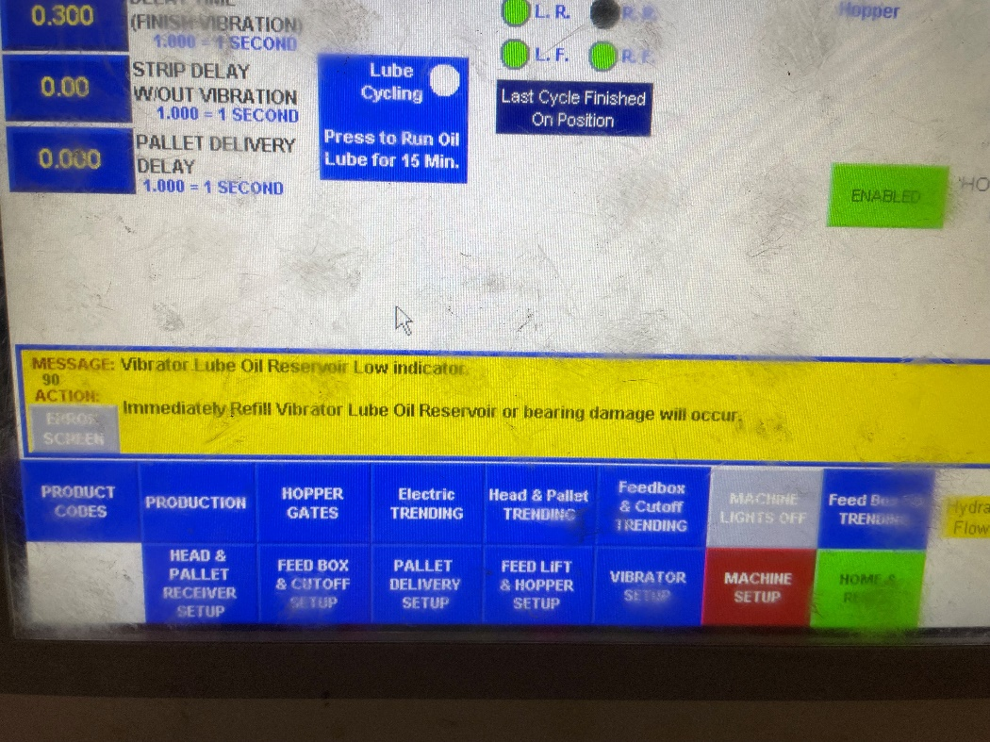
Procedure
On the HMI monitor, look for a message that says “Vibrator Oil Reservoir Low Indicator” (Figure 1).
Figure 1

Slide 4
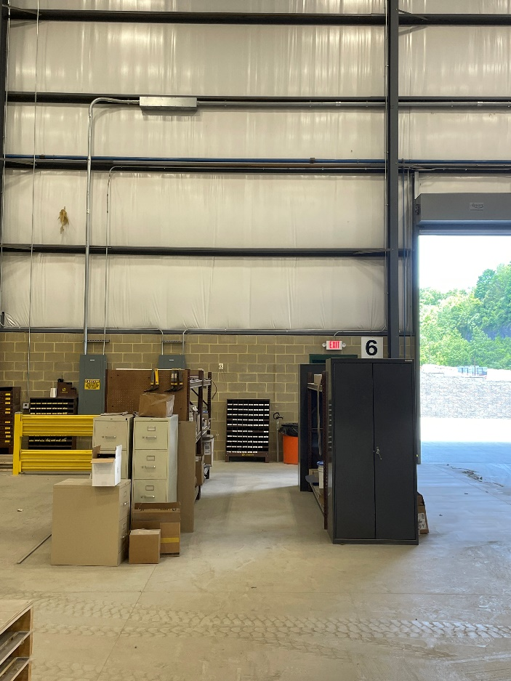
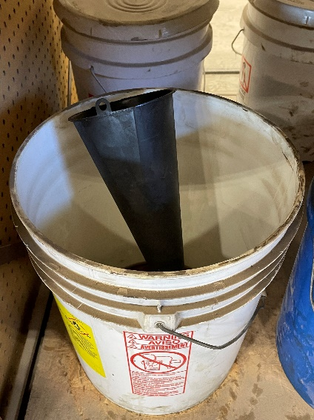
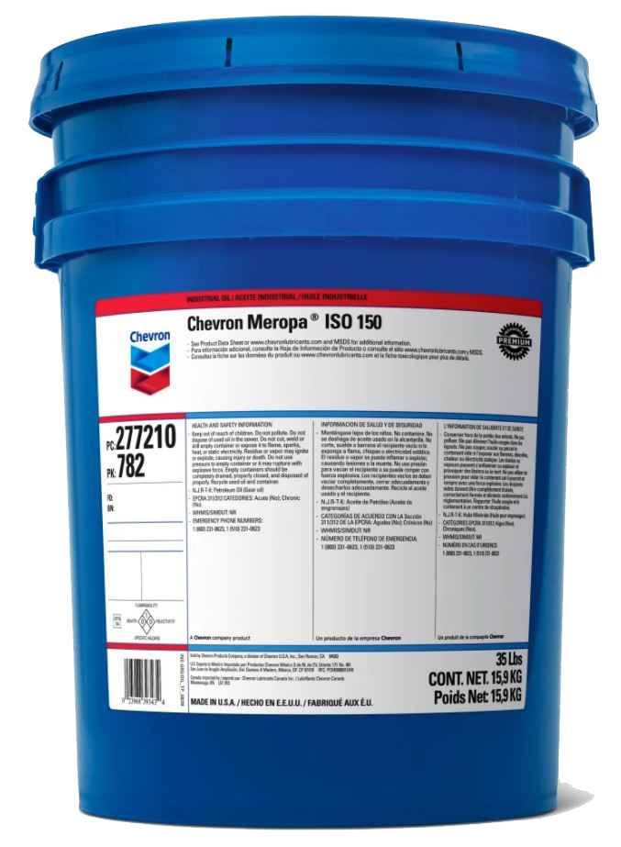
Procedure
2. On the front side of the plant where the brown shelves are located, pick up a blue “Cetus HiPerSYN Oil 150” container and the black funnel (Figure 2).
Figure 2C
Figure 2A
Figure 2B

Slide 5
Procedure
3. Check the cleanliness of the funnel. If it seems to be dirty, complete step 7 and then continue on to step 4.

Slide 6
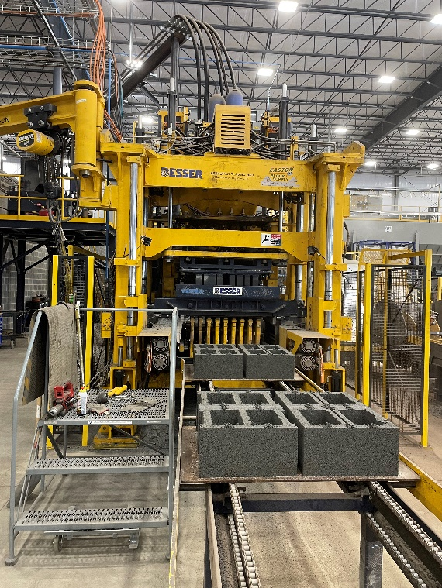
Procedure
4. Set up the ladder in front of the gate where the Lube Oil Reservoir is located (Figure 3).
Figure 3

Slide 7
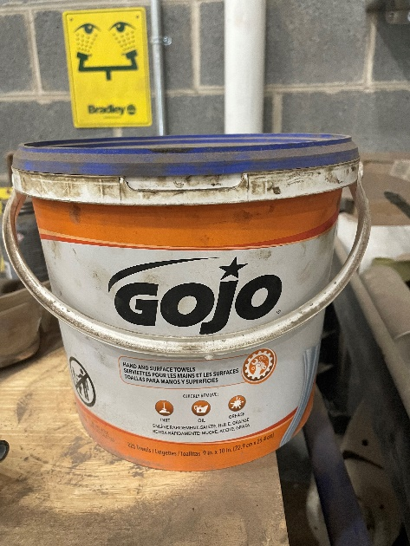
Procedure
5. Before you pour, clean off the top part of the oil reservoir with a blue surface towel that can usually be found on top of the toolbox (Figure 4). This is to prevent any dust or debris from entering through the cap.
Figure 4

Slide 8
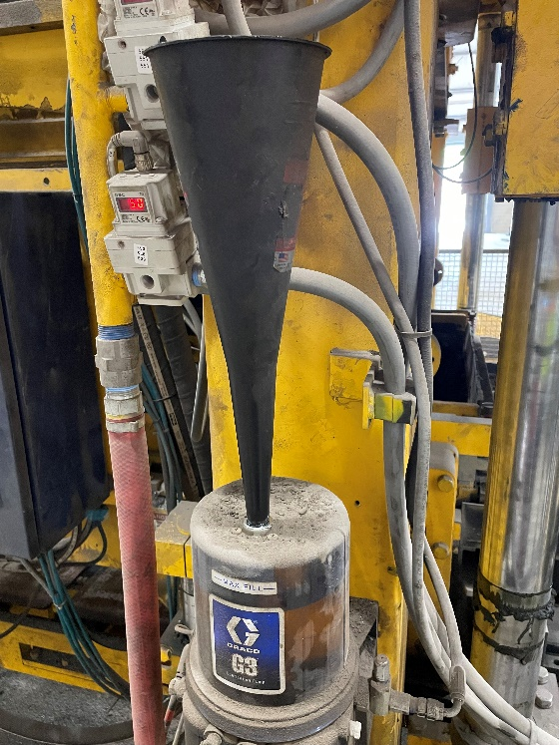
Procedure
6. Open the cap of the reservoir, put the funnel in the hole where the cap was (make sure it is firmly on) and pour the oil container into the funnel until about ¾ full. Do not exceed the “Max-Fill” mark (Figure 5).
Figure 5

Slide 9
Procedure
7. Remove the funnel and put the cap back on. Wipe down the inside of the funnel with a blue surface rag (Figure 4).
8. Return the oil accessories back in the shelves.

